Slide 1
HPGe MCNP Automated Parametric Optimization Model
Air Force Institute of Technology
6 December, 2017

Slide 2
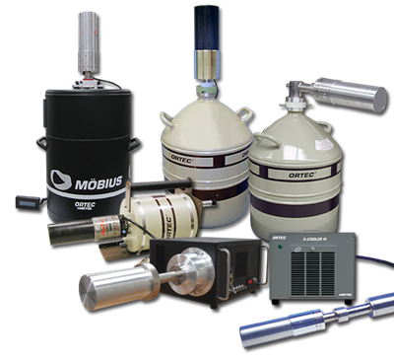
Overview
Project Goals
Previous Work
Experiment
MCNP Model
Parametric Optimization Code
Results
Conclusions
Future Work

Slide 3
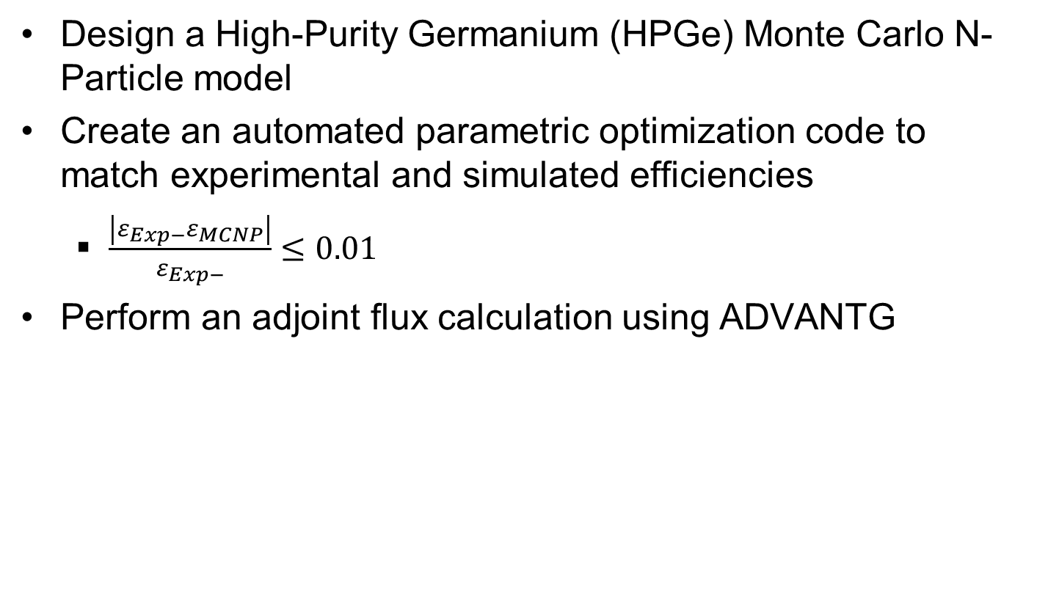
Project Goal
Design a High-Purity Germanium (HPGe) Monte Carlo N-Particle model
Create an automated parametric optimization code to match experimental and simulated efficiencies
$\frac{\left|ε_{Exp−}ε_{MCNP}\right|}{ε_{Exp−}}≤0.01$
Perform an adjoint flux calculation using ADVANTG

Slide 4
Previous Work
Manufacturer provided dimensions are often times not sufficient for developing models. ^{[1]}
Published relative differences between experimental and Monte Carlo simulated absolute efficiencies range from around 10% to as low as 0.2%. ^{[2][3]}
Dead layer thickness and the active volume may change over time. ^{[4]}

Slide 5
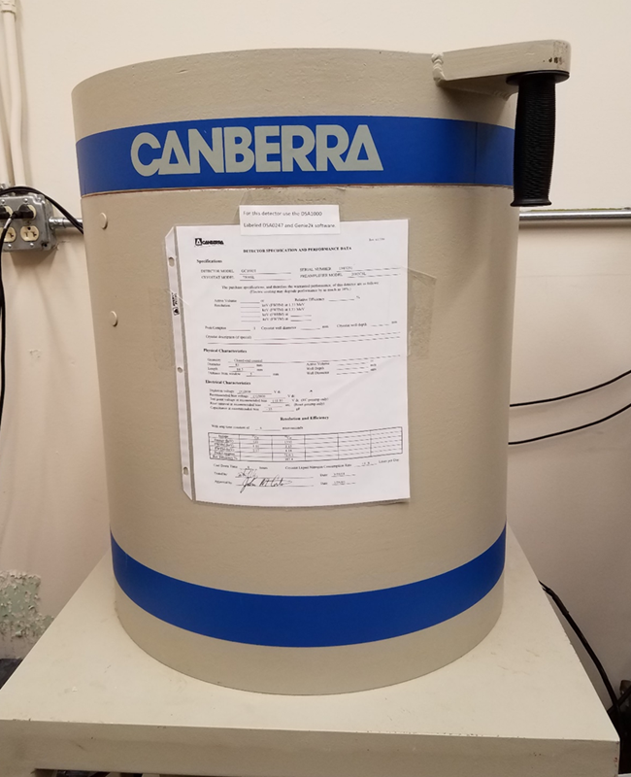
Experiment
Performed by Lt Col O’Day (April 2017)
Eckert & Ziegler Multi-nuclide source
Count time = 24 hours
5 different source positions

Slide 6
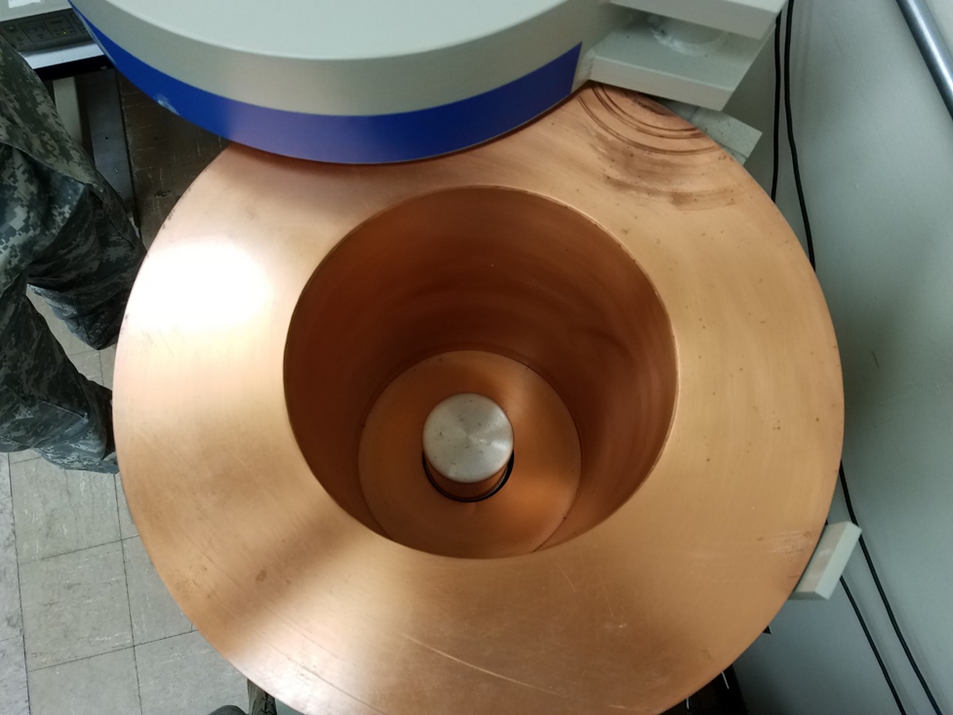
Experimental Setup

Slide 7
Experimental Setup
Gamma-Ray Energy [keV] | Nuclide | Activity [µCi] | Gammas per Second
60 | Am-241 | 0.02941 | 391.7
88 | Cd-109 | 0.2707 | 363.6
122 | Co-157 | 0.01019 | 322.7
159 | Te-123 | 0.01403 | 436.1
320 | Cr-51 | 0.3389 | 1236
392 | Sn-113 | 0.05109 | 1227
514 | Sr-85 | 0.06171 | 2247
662 | Cs-137 | 0.04325 | 1362
898 | Y-88 | 0.09633 | 3347
1173 | Co-60 | 0.05101 | 1885
1333 | Co-60 | 0.05101 | 1887
1836 | Y-88 | 0.09622 | 3539
* Energies were kept constant with manufacturer provided documentation
* Source uncertainty for each energy was 3.1%

Slide 8
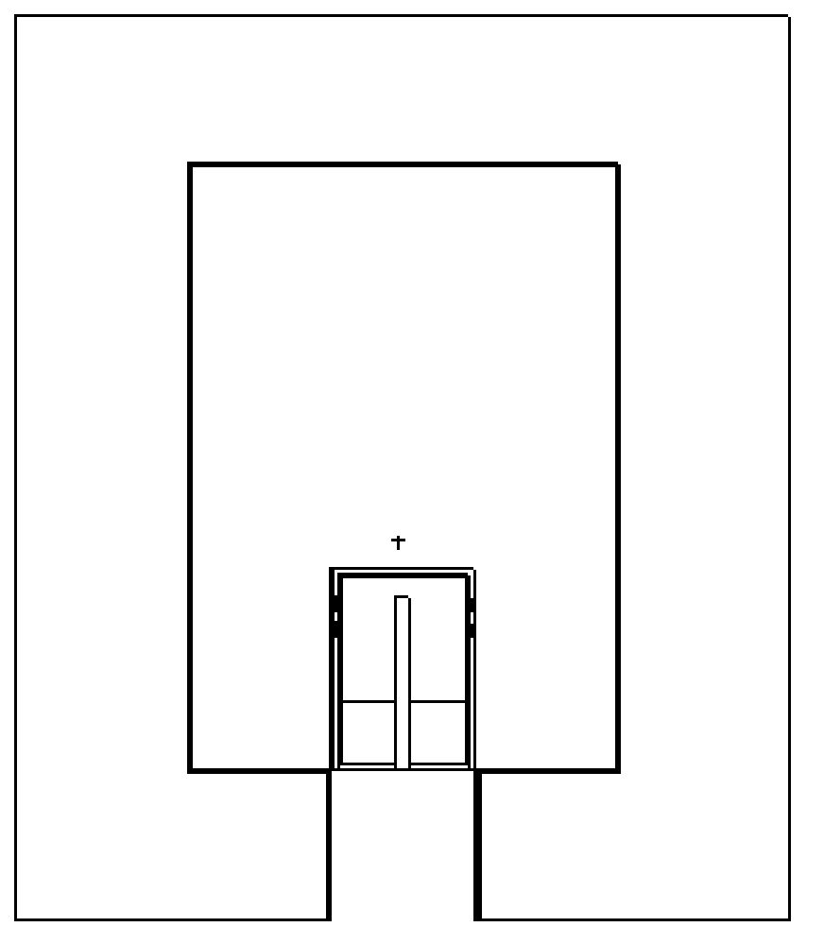
Experimental Setup
y-axis
G
5
3
A – 13.7385 cm
B – 3.48 cm
C – 4.8885 cm
D – 7.6 cm
E – 20.735 cm
F – 29.7385 cm
G – 9.78 cm
E
F
1
B
2
A
C
4
D
X-axis
(0,0)

Slide 9


Detector Specifications
Canberra Standard Electrode Ge Detector (SEGe)
Model Number: GC10021
Relative Efficiency $≥$ 100 %
Resolution: 1.20 keV at 122 keV and 2.1 at 1.3 MeV
Coaxial Configuration
P-Type
γ
p+ contact
n+ contact
e-

Slide 10
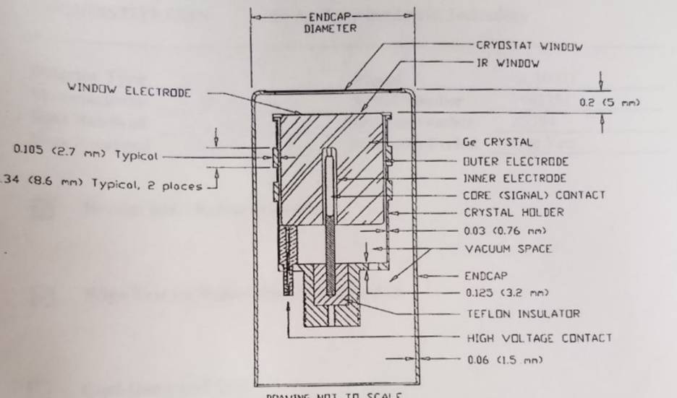
Detector Specifications

Slide 11
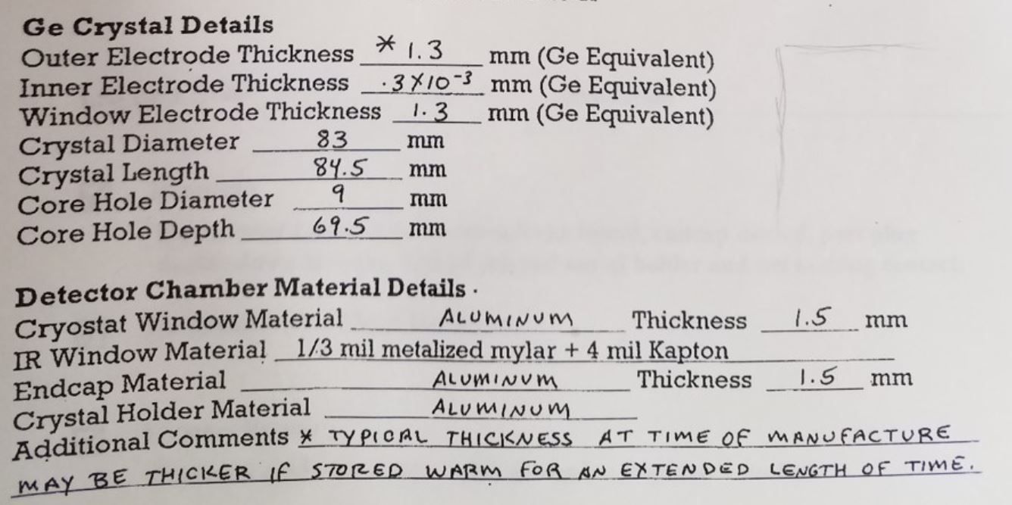
Detector Specifications

Slide 12
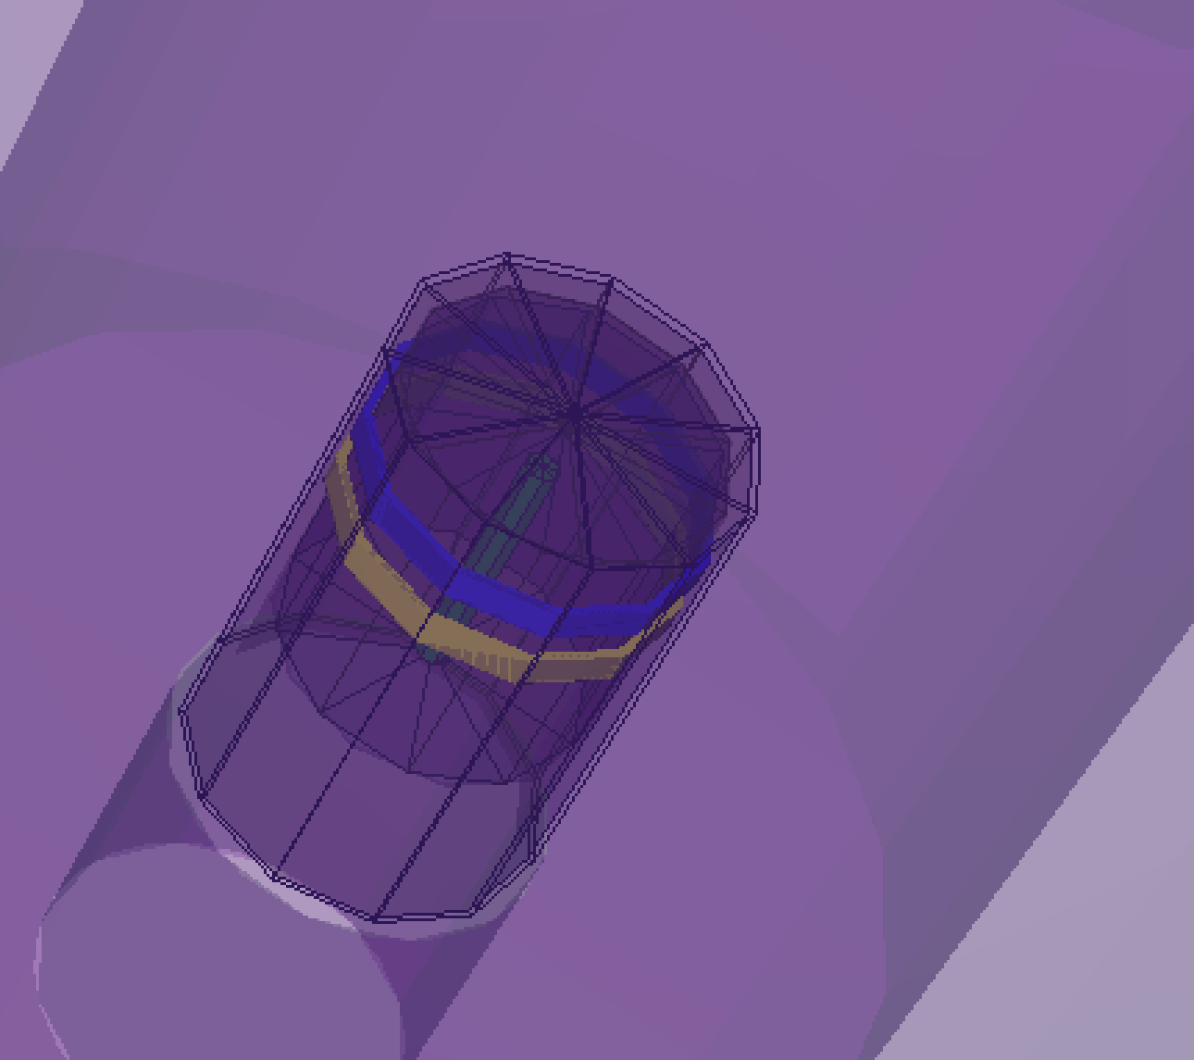
MCNP Model

Slide 13
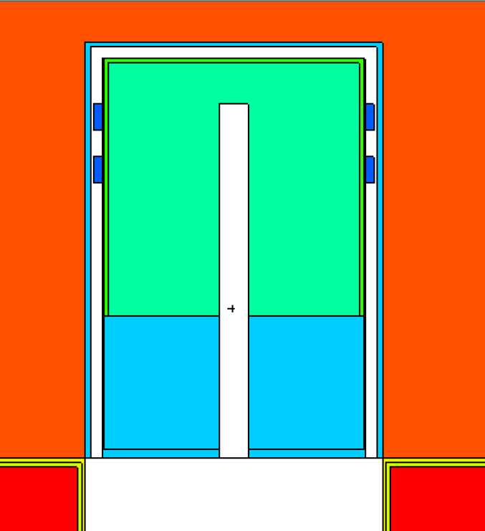
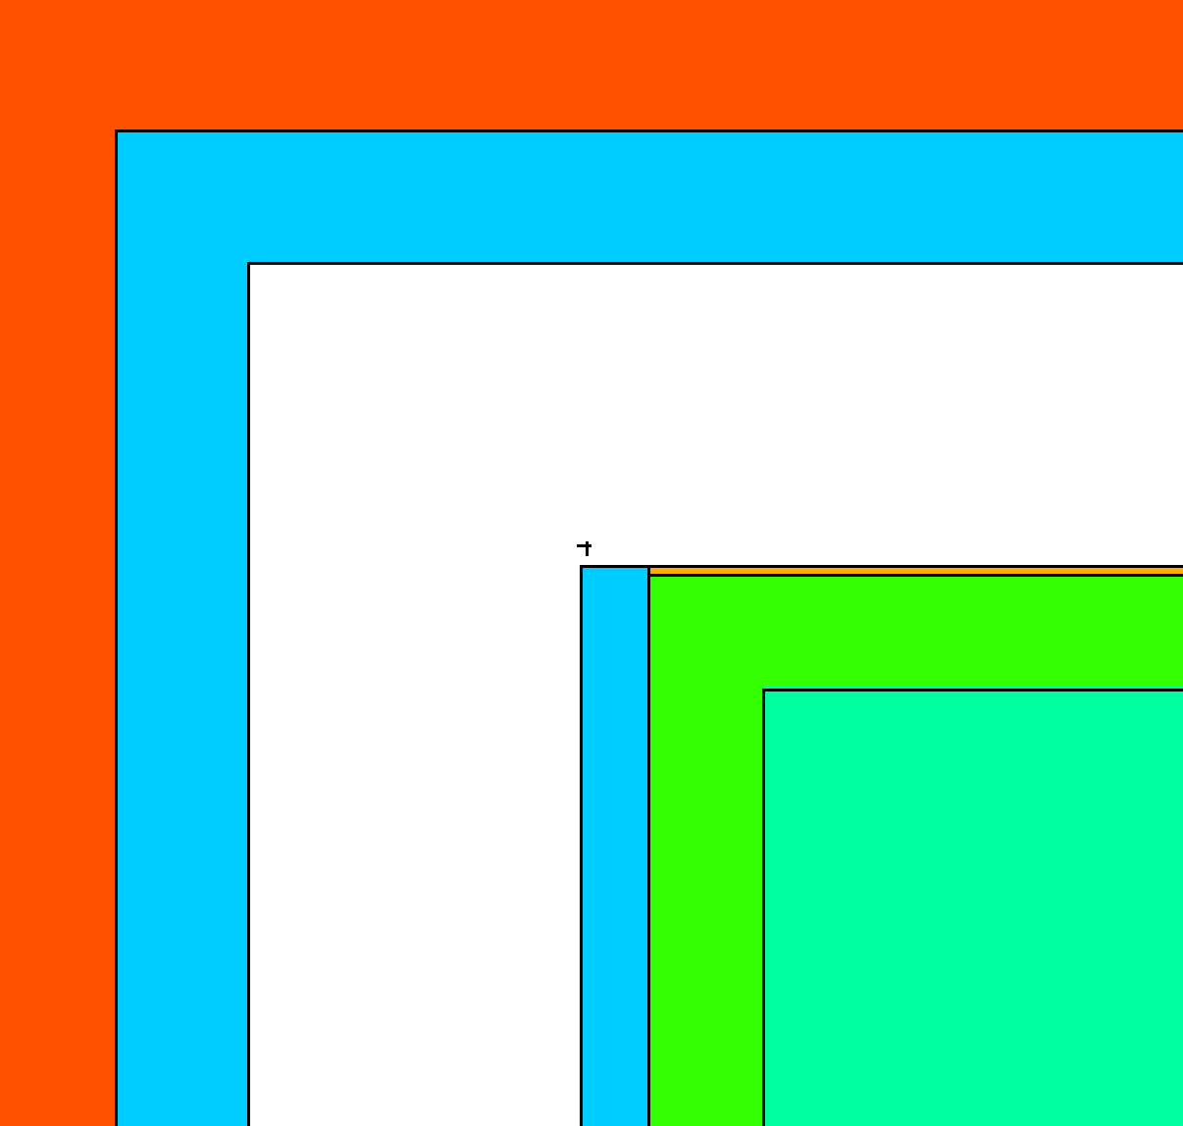
Geometry
Origin: Centered/Bottom of shielding case
Cylinders (~14 CZs)
Planes (~20 PZs)

Slide 14
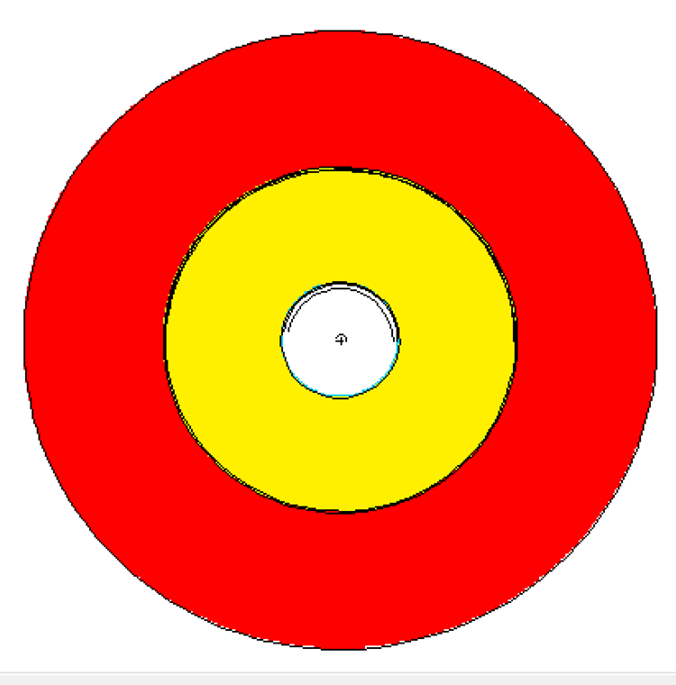
Geometry
Top View:

Slide 15
Materials
Material | Density [g/cm³] | Component(s)
Mylar | 1.38 | IR Window
Brass | 8.41 | Metal Clasps
Aluminum | 2.7 | Detector Housing and Casing
Germanium | 5.32 | Ge Crystal
Lithium | 0.534 | Outer Deadlayer
Boron | 2.73 | Inner Deadlayer
Copper | 8.96 | Shield Lining
Tin | 7.31 | Shield Lining
Kapton Film | 1.42 | IR Window
Air | 0.001224 | Shielding Chamber
Lead | 11.34 | Shielding
Acrylic Glass | 1.19 | Source Encapsulation
Vacuum | --- | Coaxial Space
* All materials from LANLs ACE Data Tables, or PNNLs Compendium of Material Composition Data for Radiation Transport Modeling

Slide 16
Photon Transport
Only photons
5 MeV upper limit
No Bremsstrahlung
No Coherent scattering
No photo fission
Doppler broadening
Notes:
Cite manual, primer, and PNNL materials

Slide 17
Source Definition
Isotropic point source
11 discrete energies
10⁶ source particles
Gaussian broadening off
Tallies:
F8 – Energy Deposition Tally
Ge Crystal (Cell 3)
8192 bins (10⁻⁵ - 3.14344 MeV)

Slide 18
Parameters to Adjust
Parameter | Initial Value
Outer Top Deadlayer | 0.13 cm
Outer Sides Deadlayer | 0.13 cm
Ge Crystal Length | 8.32 cm
Kapton Window | 0.01016 cm
Inner Top Coaxial Deadlayer | 0.00003 cm
Inner Sides Coaxial Deadlayer | 0.00003 cm
Top Al Casing Thickness | 0.15 cm
Sides Al Casing Thickness | 0.15 cm
Ge Crystal Density | 5.32 g/cm³

Slide 19
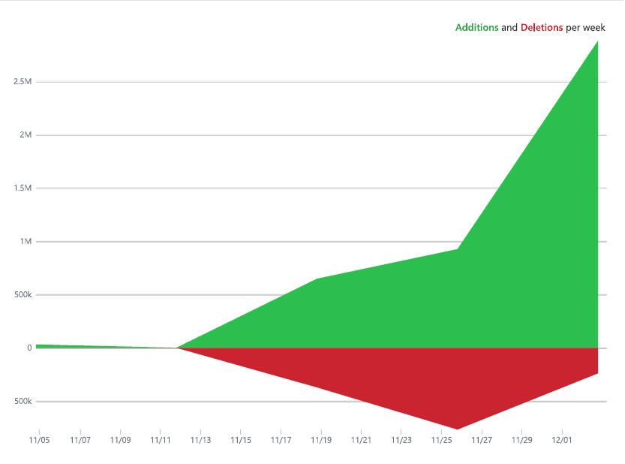
Automated Parametric Optimization Code
Overview
Process
Create Values for the Parameters
Alter the MCNP Input Deck
Run MCNP
Compare the Results
Record Clean and Reset
Add slides with any title/as many as you want to describe your code and the process
Include our performance metric for comparing experimental vs mcnp
Notes:
This is the code frequency, just to give some insight on how much was done. It is bloated a little bit since it is probably counting the Data Output files
Simple sweet and to the point. The created values are from 1] the iteration range and 2] the best value out of the previous parameter results, based on lowest Chi Squared value currently.

Slide 20
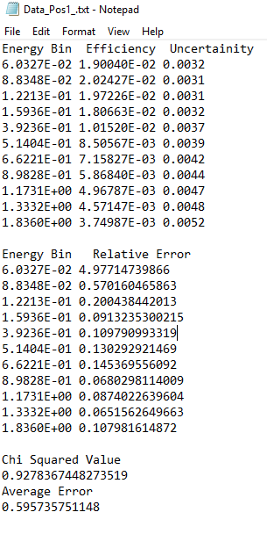
What is Created
After running MCNP the Output file is striped of its
relevant information.
Once acquired the Error and the Chi square
Can be determined
Additionally Plots are able to be created at this point

Slide 21
Before After
Notes:
Include the data from before and after showing how the default values are optimized somewhat. Also include the experimental data. Used relative error since we were trying to get near identical values compared to the given experimental data
Used an average error to simply see if any progress was made without having to look line by line.
Used a Chi Squared value ……….?

Slide 22
Plots
Notes:
Include all the plots explain that these are showing our results in comparison with the given experimental results. Note that the plots were also automated in their creation.

Slide 23
Results
Add 5 efficiency plots for experimental verse MCNP
Include a table for each too
1 plot for the combined optimal parameters
Advantage results?
Include final value for relative uncertainty

Slide 24
Conclusion
How close were we?
Does our method work?
Anything?

Slide 25
Future Work
Reach a relative percent difference of less than 1%
Increase adjustable parameters
Obtain more information about internal components of HPGe
Generalize automated optimization code for other applications:
Other detectors
Usable on other operating systems
Automated characterization simulations with benchmarked models

Slide 26
Summary
Project Goals
Previous Work
Experiment
MCNP Model
Parametric Optimization Code
Results
Conclusions
Future Work

Slide 27
Acknowledgements
Captain James Bevins, AFIT
Lt Colonel Buck O’Day, AFIT
Capt Bevins Model

Slide 28
References
[1] R. M. Keyser, "Resolution and Sensitivity as a Function of Energy and incident Geometry for Germanium Detectors," Nuclear Instruments and Methods in Physics Research Section B: Beam Interactions with Materials and Atoms, vol. 213, pp. 236-240, 2004.
[2] R. G. Helmer, R. G. Hardy, V. E. Iacob, M. Sanchez-Vega, R. G. Neilson and J. Nelson, "The use of Monte Carlo Calculations in the Determination of a Ge Detector Efficiency Curve," Nuclear Instruments and Methods in Physics Research A, vol. 511, pp. 360-381, 2002.
[3] W. F. R. R. K. M. D. O. S. C. A. C. A. X. d. S. Guilherme J. de S. Corrêa, "COMPUTATIONAL MODELING OF A HIGH PURITY GERMANIUM," in International Nuclear Atlantic Conference, Belo Horizonte,MG, Brazil, 2011.
[4] G. F. Knoll, Radiation Detection and Measurement, Hoboken, NJ: John Wiley & Sons, Inc., 2010.
[5] D. K. P. S. J. G. M. Jeremy Lloyd Conlin, "Listing of Available ACE Data Tables," Los Alamos National Laboratory, Los Alamos National Laboratory, 2013.
[6] C. G. R. P. R. R. R. W. I. RJ McConn Jr, "Compendium of Material Composition Data for Radiation Transport Modeling," Pacific North Western National Laboratory, Pacific North Western National Laboratory, 2011.
[7] R. E. F. J. K. Shultis, "An MCNP Primer," Department of Mechanical and Nuclear Engineering, Manhattan, KS, 2011.

Slide 29
Questions?

